Slide 1
The housing and mortgage market crisis of the 2000s and the policy response
Karen Pence
October 2016
Federal Reserve Board
Disclaimer: The views in this presentation are mine alone and not necessarily those of the Federal Reserve Board or its staff

Slide 2
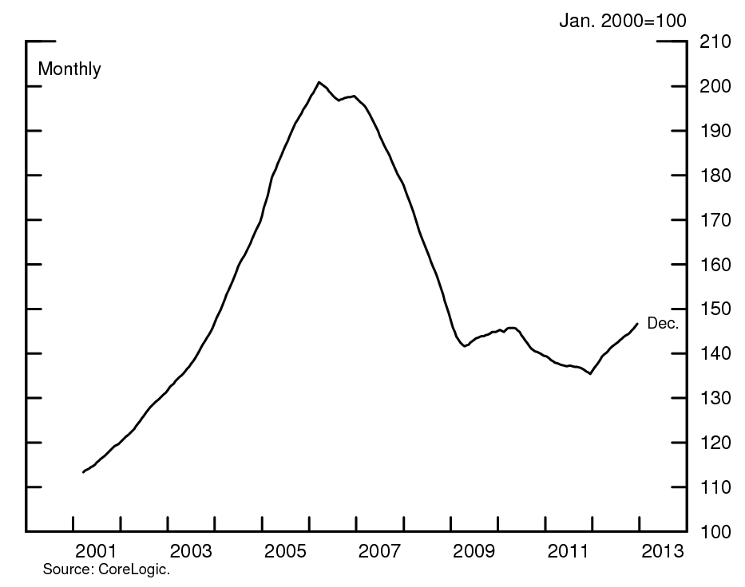
The house price cycle in the 2000s was extraordinary
Notes:
As is well known, the past 15 years have been extraordinary for house prices. House prices more than doubled from 1998 to early 2006, then fell by a third through early 2012.

Slide 3
…even from the perspective of the last 125 years
Notes:
National cycles in house prices happen fairly frequently – especially when house prices are measured in inflation-adjusted terms – but the recent episode was extraordinary in inflation-adjusted terms.

Slide 4
About $7 trillion in household wealth was lost
Source: Flow of Funds Accounts and National Income and Product Accounts.
Notes:
The decline in house prices from 2006 to 2012 corresponded to about $7 trillion in lost wealth. As shown in this graph, as scaled by disposable income, the decrease was much larger than at the time of the dot-com bubble.

Slide 5
Construction of new homes fell by 75%
Notes:
Residential investment is a fairly small component of GDP. Nonetheless, it fell from about 6 percent of GDP in 2005 to 3 percent in 2009.

Slide 6
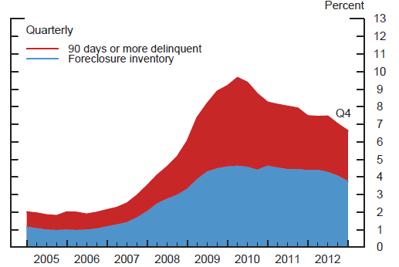
Nearly 10 percent of US mortgages were seriously delinquent in 2010
Notes:
Of course, this is a point-in-time measure. We don’t know the share of mortgages that were ever delinquent during this period.

Slide 7
The loan defaults wreaked havoc on the financial system
Mortgage-related losses crippled many financial institutions
Countrywide
Wachovia
Washington Mutual
AIG
Fannie Mae and Freddie Mac
These losses also exposed structural weaknesses in the financial system, and touched off a global financial crisis
Notes:
Countrywide was the largest… Wachovia and Wamu

Slide 8
Underwriting standards and mortgage features

Slide 9
Source: Vanessa Perry

Slide 10
Underwriting and house prices
As the housing bubble progressed, underwriting standards deteriorated and risky mortgage features became more common
This deterioration fed the bubble: borrowers who ran into trouble with one mortgage could refinance into another
When house prices began to fall, these borrowers were the first to default

Slide 11
Subprime borrowers made little or no down payments
Source: Mayer, Pence, and Sherlund, “The Rise in Mortgage Defaults,” Journal of Economic Perspectives
Notes:
This graph shows the median combined loan-to-value ratio for borrowers who took out subprime or Alt-A mortgages. Subprime mortgages are… Alt-A mortgages are…

Slide 12
Risky features became prevalent
Percent
2006 mortgage originations
Source: Mayer, Pence, and Sherlund, “The Rise in Mortgage Defaults,” Journal of Economic Perspectives

Slide 13
Most option-ARM borrowers made the minimum payment
Share of Option ARMs with Balances Larger than at Origination
Source: Mayer, Pence, and Sherlund, “The Rise in Mortgage Defaults,” Journal of Economic Perspectives

Slide 14
Early payment defaults on subprime mortgages increased dramatically
By loan vintage
Source: Mayer, Pence, and Sherlund, “The Rise in Mortgage Defaults,” Journal of Economic Perspectives
Notes:
Historically, a well-underwritten mortgage should not default in its first year, so the fact that so many mortgages went bad so quickly indicates that something was going very wrong. These data may understate the incidence of early payment defaults because lenders might have bought back mortgages that went into default in the first couple months.

Slide 15
One aspect of fraud: misrepresentation by property investors
Share of nonprime mortgages extended to property investors, by dataset
Source. Haughwout, Lee, Tracy, and vanderKlaauw (2011).

Slide 16
Credit inflows to property investors were larger than those to first-time low-score homeowners
Source. Bhutta (2016) from FRBNY Consumer Credit Panel data.

Slide 17
Loans to property investors became a large share of defaults
Investor share of borrowers entering default in each time period
Source. Bhutta (2015) from FRBNY Consumer Credit Panel data.

Slide 18
But underwriting alone cannot explain the housing collapse
Why did lenders and borrowers enter into such risky mortgage contracts?
Why didn’t market discipline damp this expansion of risky credit?
What was the market failure?
Notes:
Nonetheless, I find underwriting standards and product features to be an unsatisfying very

Slide 19
mortgage securitization

Slide 20
Mortgage securitization
Lenders hold some loans on their books
Other loans are securitized and sold to MBS investors
Roughly, the MBS investor buys the borrower’s future mortgage payments
The mortgage lender knows more than the MBS investor about the borrower and loan
Possible explanation for bad underwriting: the lender passes off bad loans to an unsuspecting MBS investor

Slide 21
Mortgage securitization increased rapidly from 2002 through 2007

Slide 22
MBS investors knew a lot about risky loans
Many risk factors--such as low- and no-doc status-were clearly disclosed
The statistics that I showed earlier were available to investors at the time
MBS investors had only partial information on second liens and on fraud
Information problems appear most prevalent among low-doc subprime loans

Slide 23
MBS investors knew a lot about default
MBS investors understood the relationship between risky characteristics and mortgage default
MBS investors’ default models generally performed well

Slide 24
Over-reliance on triple-A ratings
Most MBS were rated “triple-A” by the rating agencies.
The non-triple-A pieces were repackaged into new triple-A securities (CDOs).
MBS investors assumed that these securities were as safe as U.S. Treasuries.
Rating agency models were somewhat flawed for MBS and very flawed for CDOs.
Investors also assumed that big financial firms would step in if problems arose.

Slide 25
Buy back provisions
Lenders were required to buy back loans that defaulted early.
Some loan originators did not have much capital. When MBS investors pressed originators to buy back defaulted loans, the originators declared bankruptcy.

Slide 26
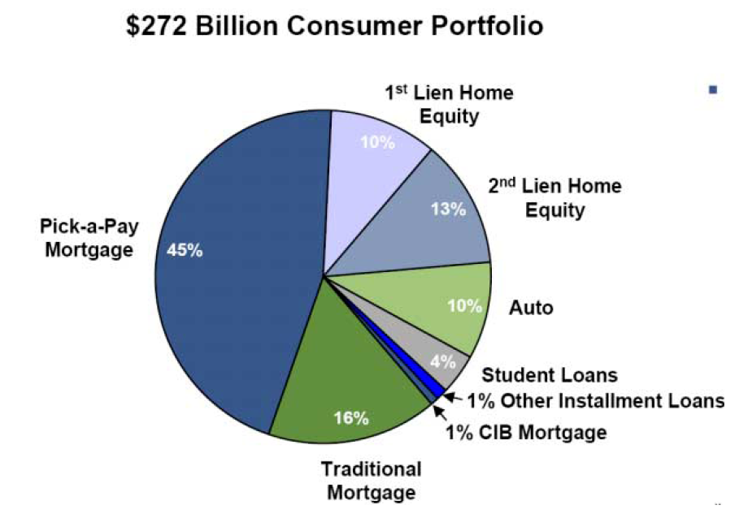
But big losses among lenders make
securitization an incomplete answer
Wachovia’s Portfolio

Slide 27
House price expectations

Slide 28
Optimism about house prices
Borrowers, lenders, MBS investors, rating agencies, and so on did not expect such a large fall in house prices.
For several years, betting on rising house prices was very profitable.
Possible explanation for lax underwriting: when house prices rise, underwriting doesn’t matter.

Slide 29
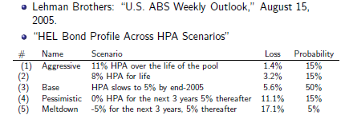
MBS investor expectations about house prices
As it turned out, house prices declined at an annual rate of 8 percent for the next three years, and 2 percent thereafter.
Source: Paul Willen.
Bord of Governors of the Federal Reserve System

Slide 30
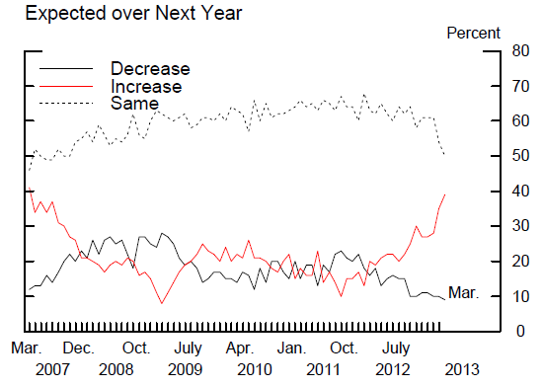
Household expectations about house prices
Source: Reuters/University of Michigan Survey of Consumers

Slide 31
Households consider home purchases as safe as savings accounts
Share considering investment “safe”
Source: Fannie Mae housing survey.

Slide 32
This answer sparks more questions
How do house price expectations get formed?
Can we identify house-price bubbles in real time?
How can we affect house price expectations?

Slide 33
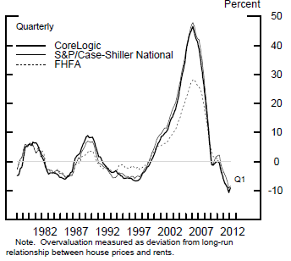
We knew in real time that house prices were high relative to rents

Slide 34
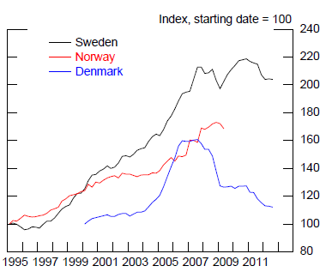
But when would prices fall? Price-rent ratios in Scandinavia

Slide 35
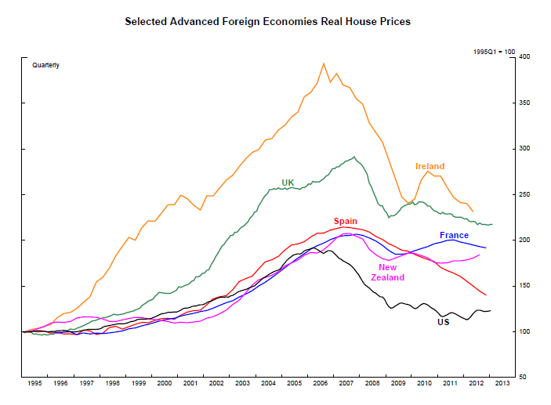
Notes:
Other countries had much larger house price booms than the United States. It is hard to reconcile any US-based story with the international experience.

Slide 36
The policy response

Slide 37
Risky mortgage products
Mortgages with negative amortization and interest-only features are much harder to obtain in the United States
Fannie Mae and Freddie Mac will not purchase loans that have these features
Such loans cannot be “qualified mortgages” as defined by the Consumer Financial Protection Bureau, which means that lenders who originate them have a greater risk of being sued by borrowers

Slide 38
Underwriting and fraud
The qualified mortgage / ability-to-repay rule also requires lenders to document income and conduct responsible underwriting
A variety of other reforms and regulations have reduced the potential for fraud in appraisals and improved the accuracy of paperwork

Slide 39
House prices
Federal Reserve stress tests require large banks to consider whether they have enough capital in the event of a fall in house prices
Under the proposed counter-cyclical capital buffer, the Fed can require banks to hold more capital if house prices seem over-valued
Fannie Mae/Freddie Mac are selling credit-risk transfer securitizations, which provide market gauges of house-price risk

Slide 40
Resilience of financial system overall
Stronger and macroprudentially focused supervision
Higher and better quality capital requirements
Liquidity requirements
Stress tests and capital planning requirements
Financial Stability Oversight Council can designate institutions as systemically important

Slide 41
What is not done?
Reform of Fannie and Freddie
Meaningful reforms to credit-rating agencies
(More) regulation of non-banks involved in the mortgage credit process
Macroprudential tools such as time-varying loan-to-value ratios

Slide 42
Conclusions
The housing and mortgage bubble was fueled by unrealistic house price expectations
The rise in house prices was enabled and sustained by increasingly lax underwriting
Financial market imperfections also played a role.
We still have much to learn about house price boom-and-bust cycles

